Slide 1
Pneumonia Detection from Chest X-rays Using CNN Models
Author: Mawada Mohammed University of Khartoum – Faculty of Medical Laboratory Science

Slide 2
Introduction
Pneumonia is a serious respiratory infection affecting millions worldwide, often requiring prompt and accurate diagnosis for effective treatment.
Analyzing chest X-rays is a common diagnostic method, but it can be challenging and time-consuming.
Our research explores the use of Convolutional Neural Networks (CNNs) for automated and accurate pneumonia detection from chest X-rays.

Slide 3
CNNs: Learning from Image Data
CNNs are a powerful type of deep learning algorithm specifically designed for image analysis.
They learn hierarchical features from image data, enabling them to detect complex patterns and make accurate predictions.
By training on a large dataset of labeled X-rays, our CNN can effectively distinguish between pneumonia and healthy lungs.

Slide 4
Methodology
1. Dataset: We used a dataset of chest X-ray images, each labeled as either "Pneumonia" or "Normal".
2. Data Preprocessing: Images were resized and normalized to prepare them for the CNN.
3. Model Training: We trained a CNN architecture on the prepared dataset, optimizing for accuracy.
4. Model Evaluation: The trained model was rigorously evaluated on a separate test dataset to measure its performance.

Slide 5
Results: Achieving High Accuracy
Training Performance
- Loss: 0.1
- Accuracy: 0.94 (94%)
Test Performance
- Loss: 0.5
- Accuracy: 0.8 (80%)

Slide 6
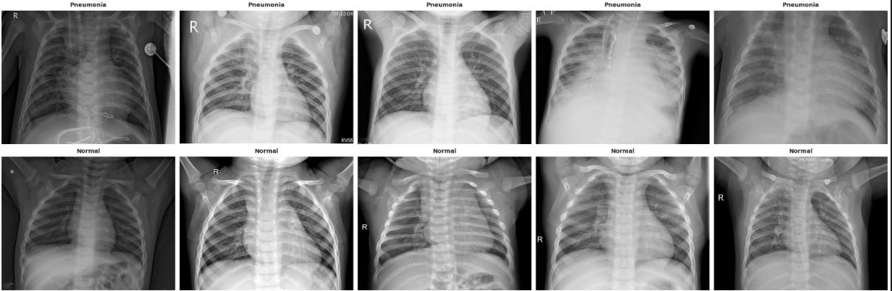
Visualization: Understanding Model Predictions
These visualizations provide insights into the model's performance, highlighting its strengths and areas for potential improvement.

Slide 7
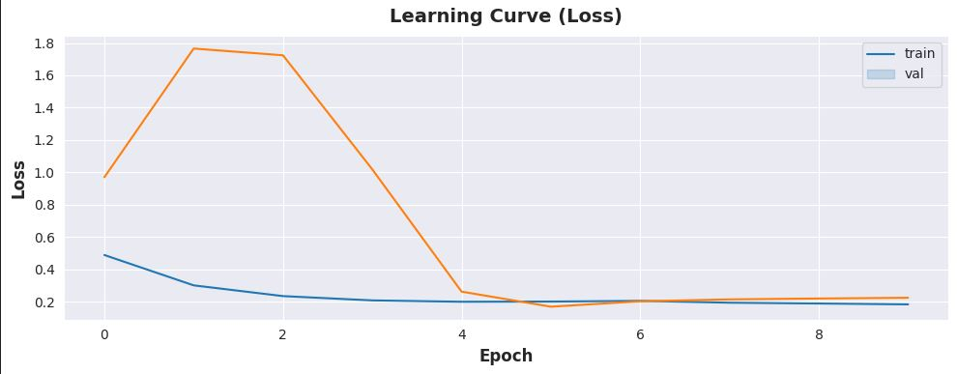

Slide 8
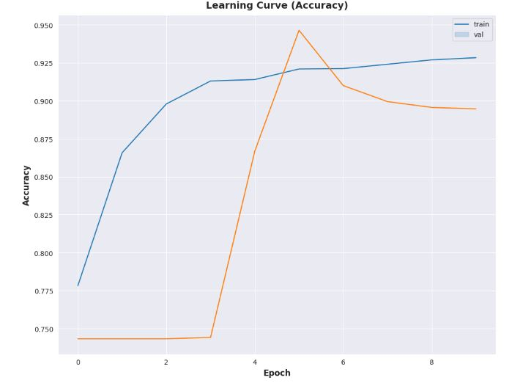
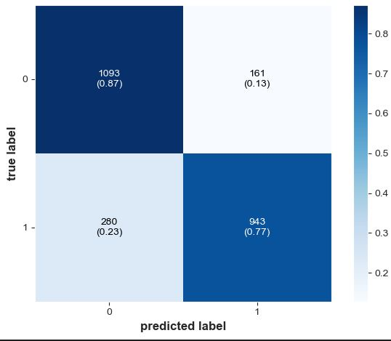

Slide 9
Discussion: Impact and Future Work
Our results demonstrate the effectiveness of CNNs for pneumonia detection from chest X-rays, achieving high accuracy on both training and test datasets.
This technology can assist healthcare professionals in making faster and more accurate diagnoses, potentially improving patient care and outcomes.
Future work will focus on:
- Expanding the dataset with more diverse cases.
- Exploring different CNN architectures and hyperparameter tuning to further enhance performance.
- Developing a user-friendly interface for integration into clinical workflows.

Slide 10
Conclusion
Our research showcases the power of CNNs for automated pneumonia detection from chest X-rays, offering a promising solution for faster and more accurate diagnosis.
This technology has the potential to revolutionize medical image analysis, ultimately improving patient care and global healthcare accessibility.

